Slide 1

Lectures, Slides, & Q&A: 3. Dasgupta
Lecture slides with audio:
Activity flow
<https://github.com/braddelong/public-files/blob/master/econ-115-module-0-lecture-1-activities-%23tceh.pptx>
The educational process
<https://github.com/braddelong/public-files/blob/master/econ-115-module-0-lecture-2-education-process-%23tceh.pptx>
Dasgupta’s take on economics
<https://github.com/braddelong/public-files/blob/master/econ-115-module-0-lecture-3-dasguptas-takes-%23tceh.pptx>
Logistics
<https://github.com/braddelong/public-files/blob/master/econ-115-module-0-lecture-4-logistics-%23tceh.pptx>
Link
Link

Slide 2
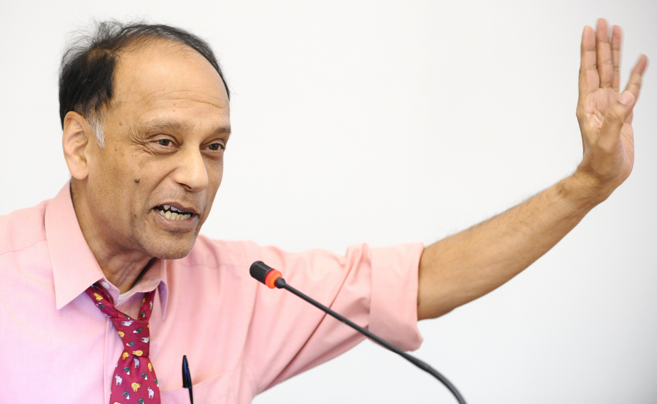

Lecture: Dasgupta on Doing Economics
Why would one want to “think like an economist”?:
What is “thinking like an economist”?:
Cost-benefit
Opportunity cost
System equilibrium
Marginality
This turns out to be useful for thinking about the economy:
(Other things too: but mostly the economy)
——
Sir Partha Sarathi Dasgupta, FRS, FBA (born 17 November 1942) is Frank Ramsey Professor Emeritus of Economics at the University of Cambridge, Fellow of St John's College, Cambridge, and Visiting Professor at the New College of the Humanities, London. He was born in Dhaka, present-day Bangladesh
2:45 audio; 6:15 of audio in this slide group
Notes:
As I already said, this is not just a history course, but an economic history course. (And this is not just an economics course, but an economic history course.) In the next module we will get into what it means to take a historical view of a subject or a situation. In this module we are looking into what it means to take an economic view. Hence we had you read Dasgupta—to remind those of you have forgotten Econ 1 what economics is as a way of thought, and to reinforce in all of you your grasp of economics by providing you with what Partha Dasgupta thinks economics is for.
Dasgupta provides a non-standard introduction. Your standard introduction would set out perhaps four fundamental principles—for example, that (i) people have likes and dislikes, and thus that decisions and situations have, for the people involved, both benefits and costs; (ii) even things that seem unmixed blessings have costs—opportunity costs—for choosing to do good thing X often means that you are giving up the opportunity to do good thing Y; (iii) people’s actions interact because people are interdependent, often the vector sum of their actions and interactions will be a result that nobody intended to bring about or perhaps even wished to see, and that societies will fall into patterns of activity that reproduce themselves in the sense of providing nobody with an incentive to do anything differently—reach a system equilibrium—and (iv) that the most important individual decisions in determining the ultimate societal outcome will be the marginal decisions, the decisions made by the people who could have most easily and straightforwardly chosen otherwise.
It would then apply these principles and teach you to do things like calculate equilibrium quantities produced and sold and prices charged in the market for some good or service.
Partha Dasgupta takes a different view. He asks a game theorist’s question: how do people fall into the patterns of interaction and exchange they do? And what makes those patterns especially productive or unproductive? In so doing he attempts to model “thinking like an economist”? And he hopes that readers, by watching and following his thoughts, will be taught an answer to the question: why would one want to “think like an economist”?:
You should also think about why this economic way of thinking is particularly useful in thinking about the economy. A hint: there is an old line about the difference between economics and sociology that goes like this: economics is all about how people make choices, and sociology is about how people do not have any important choices to make.
And think about what kinds of things an economic view is likely to see especially clearly. And think about what kinds of things an economic view is likely to fail to see at all.
——
Sir Partha Sarathi Dasgupta, FRS, FBA (born 17 November 1942) is Frank Ramsey Professor Emeritus of Economics at the University of Cambridge, Fellow of St John's College, Cambridge, and Visiting Professor at the New College of the Humanities, London. He was born in Dhaka, present-day Bangladesh

Slide 3
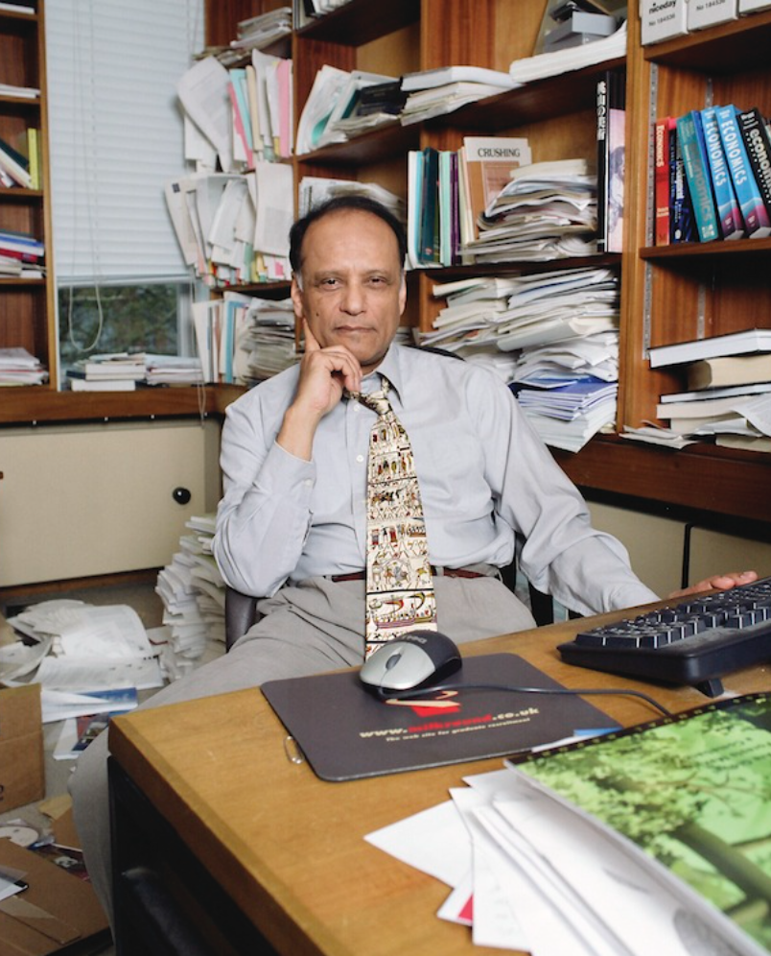
What Is the Economy?
And why is thinking like an economist the best way to analyze it?:
These are the questions Dasgupta sets out to answer by example in his book
It is a game theorist’s introduction to economics
The book won’t teach you how to calculate price and quantity changes in response to demand shocks.
The book will teach you why figuring out price and quantity changes is a worthwhile thing to do.
This is worth getting into your frontal brain lobes:
We are going to spend the semester studying the growth of the human economy
And we are going to do so by thinking like economists.
Anthology intelligence; division of labor, mechanism design; societal calculating machine
2:45 audio
Notes:
This book definitely will not teach you how to calculate price and quantity changes in response to demand shocks. That is not Dasgupta’s purpose. This book will, hopefully, teach you why figuring out price and quantity changes is a worthwhile thing to do.
This is worth getting into your frontal brain lobes, for we are going to spend the semester studying the growth of the human economy, and we are going to do so by thinking like economists.
Partha Dasgupta does model thinking like an economist: he focuses on what is going on at the margin, he looks at costs and benefits, he considers opportunity costs, and most of all he thinks in general equilibrium—how a society reaches situations in which patterns of interaction are stable, what those patterns are, and behind that the game theoretic foundations of what makes those patterns of interaction productive and unproductive.
Dasgupta's observations on the nature and causes of the wealth of nations are, I think, usefully thrown into four bins: anthology intelligence, division of labor, mechanism design, and societal calculating machines.
Because we can talk and write, we are an anthology intelligence: your brain is of use to me and my brain is of use to you, and what one of us knows or learns can be very quickly disseminated to the human race as a whole. This intellectual force multiplier makes us really smart—much smarter than any one of us could be if they had to reason things out from first principles and observations. But in order for human society to work, we need to build a system in which people are incentivized to share information rather than to transmit misinformation.
One of the things our smartness as an anthology intelligence has uncovered is the huge benefits of the division of labor: if we each specialize and each do a piece of the job, we can massively magnify our productivity. But, once again, something has to happen for society to work: we need to build into it systems in which people are incentivized to cooperate productively, rather than to steal or to hold up others.
These two lead us to the ideas of mechanism design: what societal mechanisms have we built so that we can trust each other? And how well do these mechanisms work—at what scale can we trust each other? And how can we set up a process for designing better societal mechanisms?
These thoughts lead to one of the punchlines: a properly-designed and properly-regulated market economy is an extraordinarily useful societal calculating machine for telling us what we need to do to develop knowledge, spread knowledge, and cooperate to productively use knowledge. An ill-designed or improperly-regulated market economy? Not so much.

Slide 4
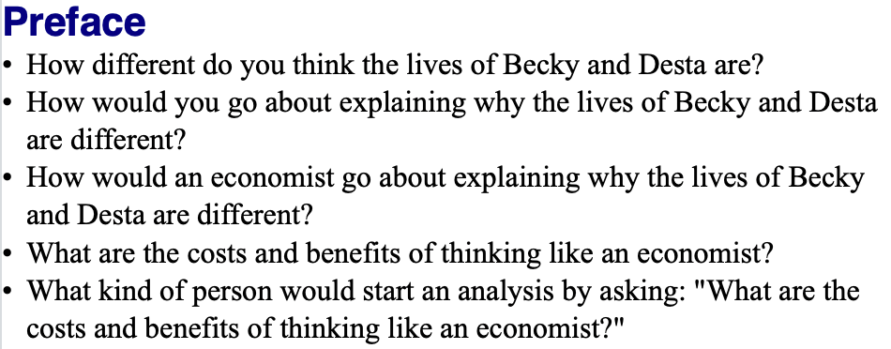
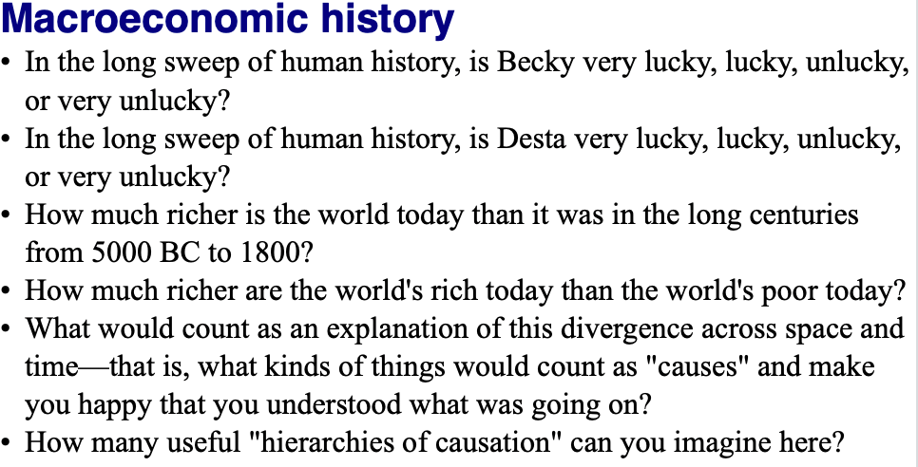
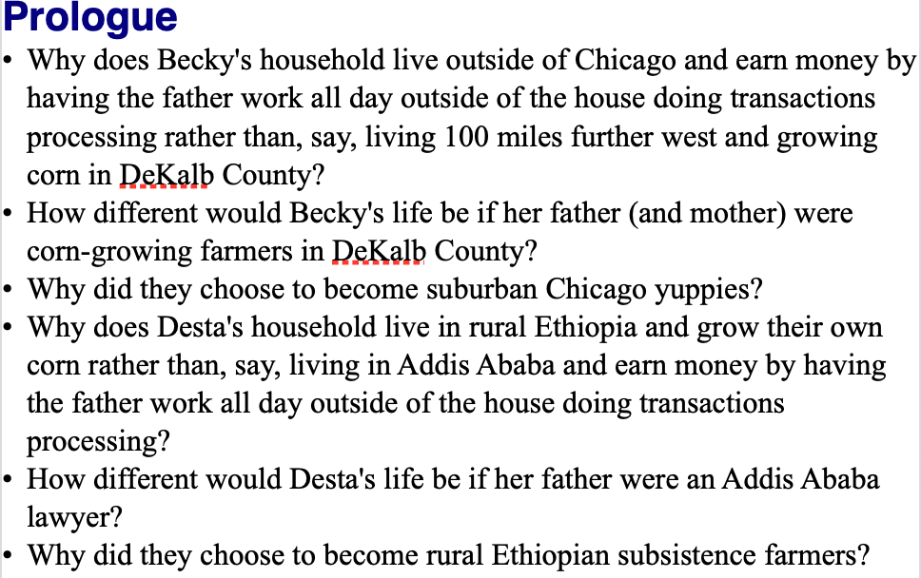
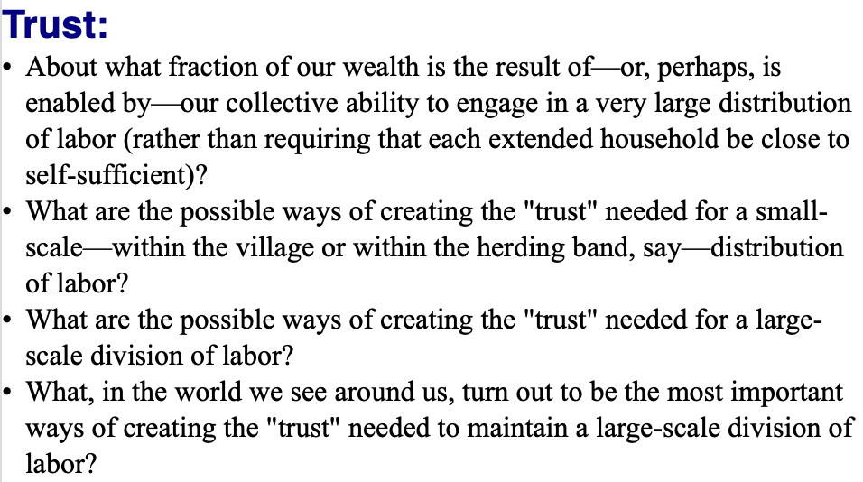
Questions
0:45 audio
Notes:
We have a number of discussion questions on Dasgupta’s little book—from 3 to 7 per chapter. Indeed, we could teach a whole course on this little book. It would be fun to do. (We would, however, have to add auxiliary readings.)
As you page through and read this and the following two slides, see how many of these questions you can successfully answer to your satisfaction off the cuff. That is a good index of the extent to which you are already engaging in “active reading”.
If your scores are low, I would advise you to think hard about what you need to do to retool how you read books, at least the books you wish to obtain some form of deep and durable knowledge from.

Slide 5
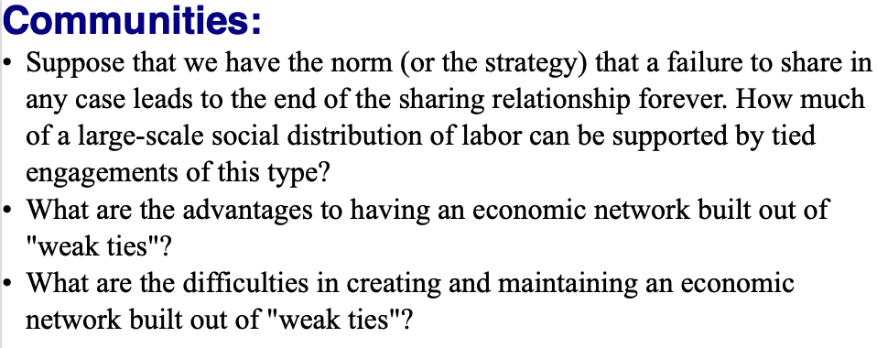
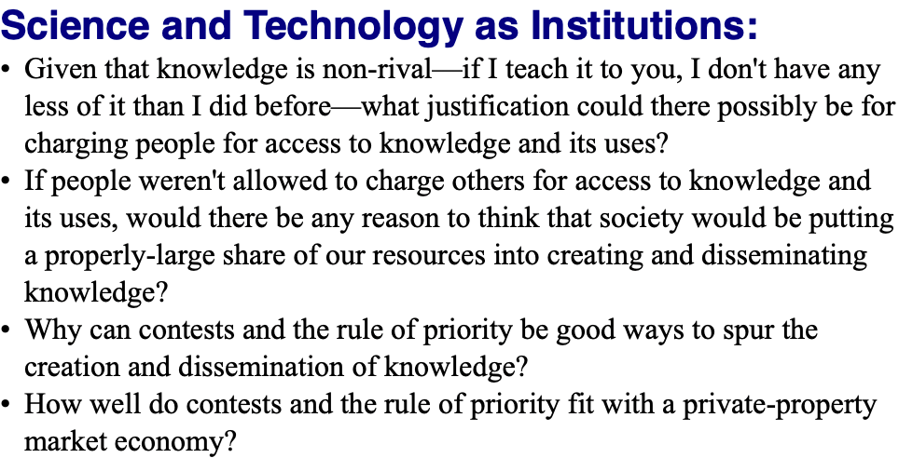
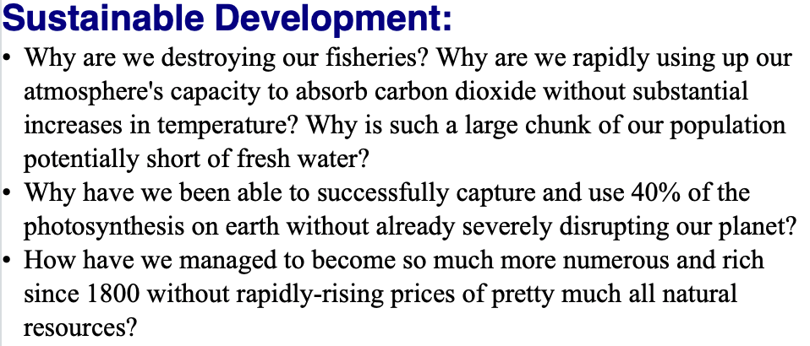
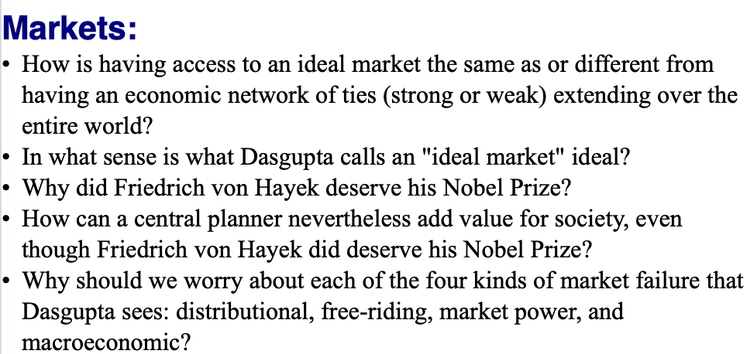
Questions II
0:00 audio

Slide 6
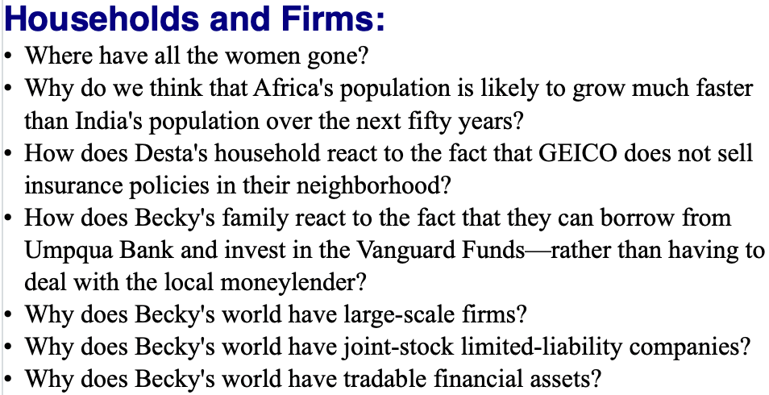
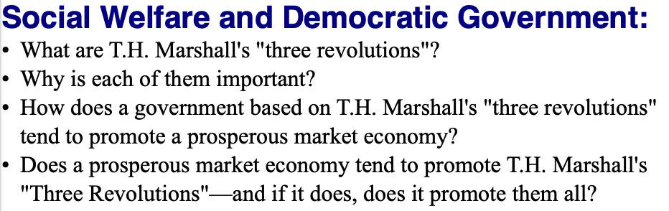
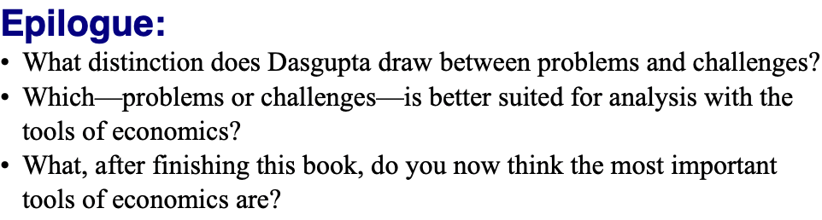
Questions III
0:00 audio

